Slide 1



The effect of acute and repeated stress on excitatory neurons in the female rat dorsomedial hypothalamus
Ruby Muzzatti, Dr Karen Crosby
Department of Biology, Mount Allison University, Sackville, New Brunswick
Notes:
Need NBIF?

Slide 2
Background
Modern food landscape
high calorie
highly palatable
ultra-processed
High obesity rates in New Brunswick
Evidence of sex differences in food intake under chronic stress but what about acute stress?
Notes:
VERY COMPLEX but there is evidence in chronic stress, so what about acute stress, and what is the neurophysiological basis of this?

Slide 3
Hypothalamic-Pituitary-Adrenal Axis
Acute stress
Sympathetic
Nervous
System
Norepinephrine ↓ appetite
Epinephrine ↓ appetite
CRH ↓ appetite
ACTH
Cortisol ↑ appetite
Notes:
Blunted stress response

Slide 4
Hypothalamic-Pituitary-Adrenal Axis
Repeated stress
Sympathetic
Nervous
System
Norepinephrine ↓ appetite
Epinephrine ↓ appetite
CRH ↓ appetite
ACTH
Increases consumption of highly palatable “comfort foods”
Cortisol ↑ appetite
Risk factors for increased food intake under chronic stress in humans include being female, overweight, or having a history of food restriction
Notes:
Blunted negative feedback response
In additional to weakening your immune system…

Slide 5
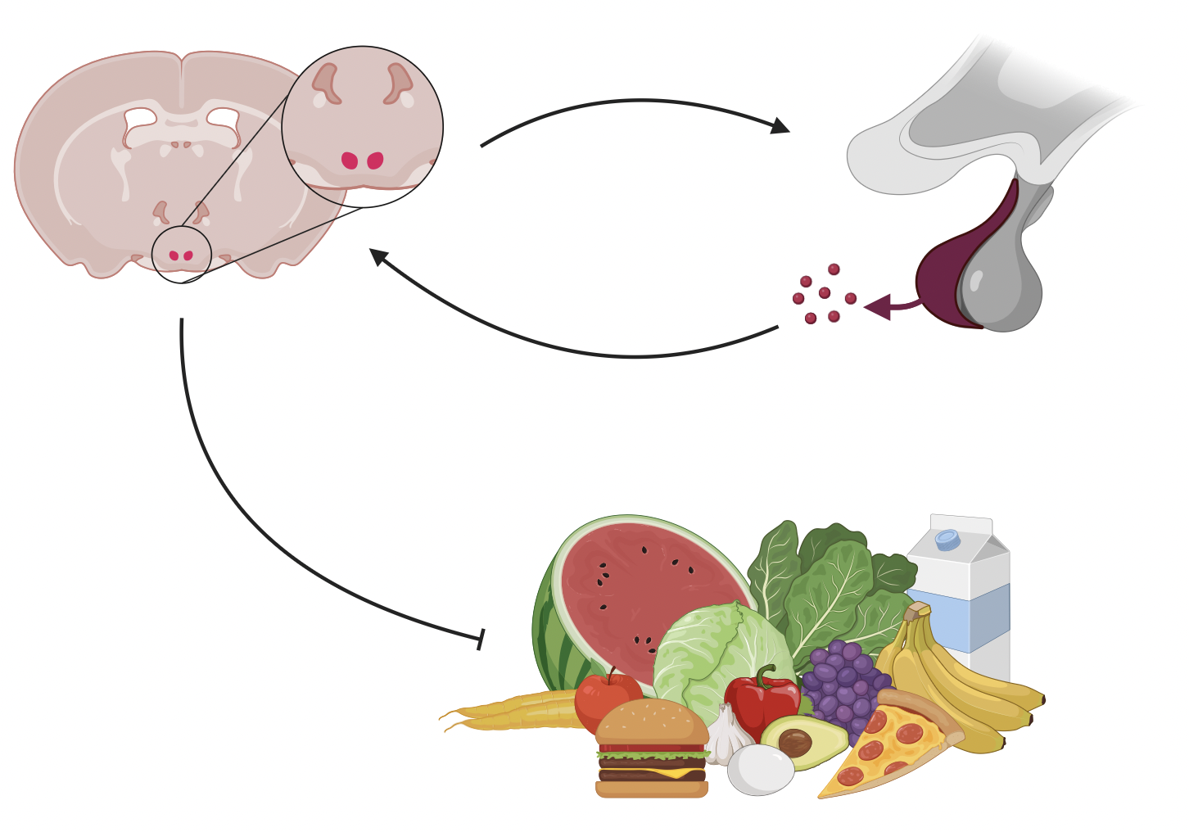
Why study the DMH?
Notes:
The DMH is involved in a lot of processes, including regulation of heart rate during stress, thermoregulation, and super importantly the regulation of appetite and body weight
Remember those glucocorticoid receptors?
Glutamate projections play a role in the stress response

Slide 6
Why study the DMH?
Notes:
The DMH is involved in a lot of processes, including regulation of heart rate during stress, thermoregulation, and super importantly the regulation of appetite and body weight
Remember those glucocorticoid receptors?

Slide 7
Why study the DMH?
Notes:
The DMH is involved in a lot of processes, including regulation of heart rate during stress, thermoregulation, and super importantly the regulation of appetite and body weight
Remember those glucocorticoid receptors?

Slide 8
Why study the DMH?
Notes:
The DMH is involved in a lot of processes, including regulation of heart rate during stress, thermoregulation, and super importantly the regulation of appetite and body weight
Remember those glucocorticoid receptors?

Slide 9
Does acute stress and repeated stress affect glutamate transmission in DMH neurons of young female rats? If so, by what mechanism?
Notes:
Hypothesis: acute stress will alter neuronal excitability and communication in the DMH
Prediction: acute stress will decrease transmission of glutamate and activity of DMH neurons

Slide 10
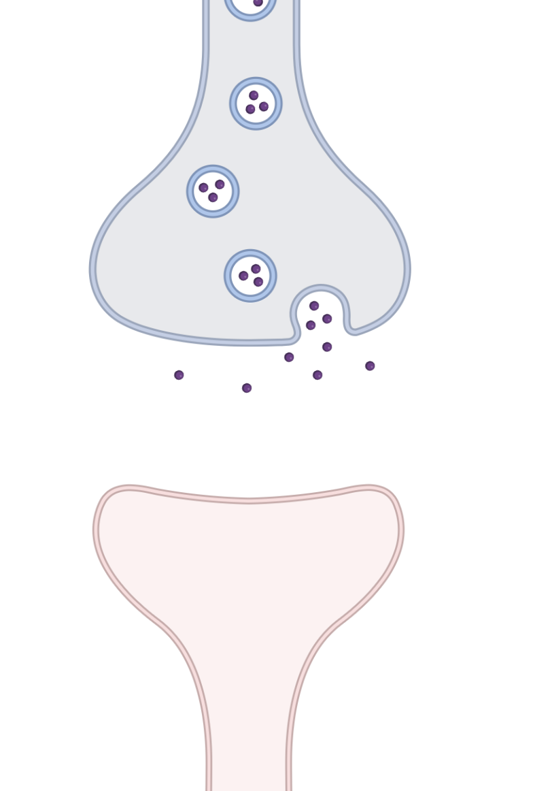
Presynaptic neuron
Nervous System Basics
Synaptic Cleft
Postsynaptic neuron
Notes:
The nervous system uses chemical (neurotransmitter) and electrical signals to communicate
Electrical stimulation comes down, NT releases from the presynaptic neuron into the synaptic cleft, and then those NT make the postsynaptic neuron more or less likely to fire an action potential for this to continue

Slide 11
Presynaptic neuron
Nervous System Basics
Electrical
Synaptic Cleft
Postsynaptic neuron
Notes:
The nervous system uses chemical (neurotransmitter) and electrical signals to communicate
Electrical stimulation comes down, NT releases from the presynaptic neuron into the synaptic cleft, and then those NT make the postsynaptic neuron more or less likely to fire an action potential for this to continue

Slide 12
Presynaptic neuron
Nervous System Basics
Electrical
Neurotransmitter
Synaptic Cleft
Postsynaptic neuron
Notes:
The nervous system uses chemical (neurotransmitter) and electrical signals to communicate
Electrical stimulation comes down, NT releases from the presynaptic neuron into the synaptic cleft, and then those NT make the postsynaptic neuron more or less likely to fire an action potential for this to continue

Slide 13
Presynaptic neuron
Nervous System Basics
Electrical
Neurotransmitter
Synaptic Cleft
Postsynaptic neuron
Notes:
The nervous system uses chemical (neurotransmitter) and electrical signals to communicate
Electrical stimulation comes down, NT releases from the presynaptic neuron into the synaptic cleft, and then those NT make the postsynaptic neuron more or less likely to fire an action potential for this to continue

Slide 14
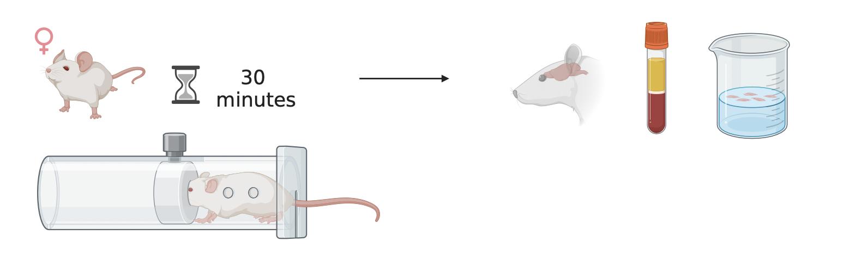
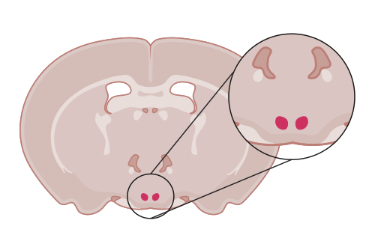
Methods: Stress
Single restraint for acute
5 consecutive days for repeated

Slide 15
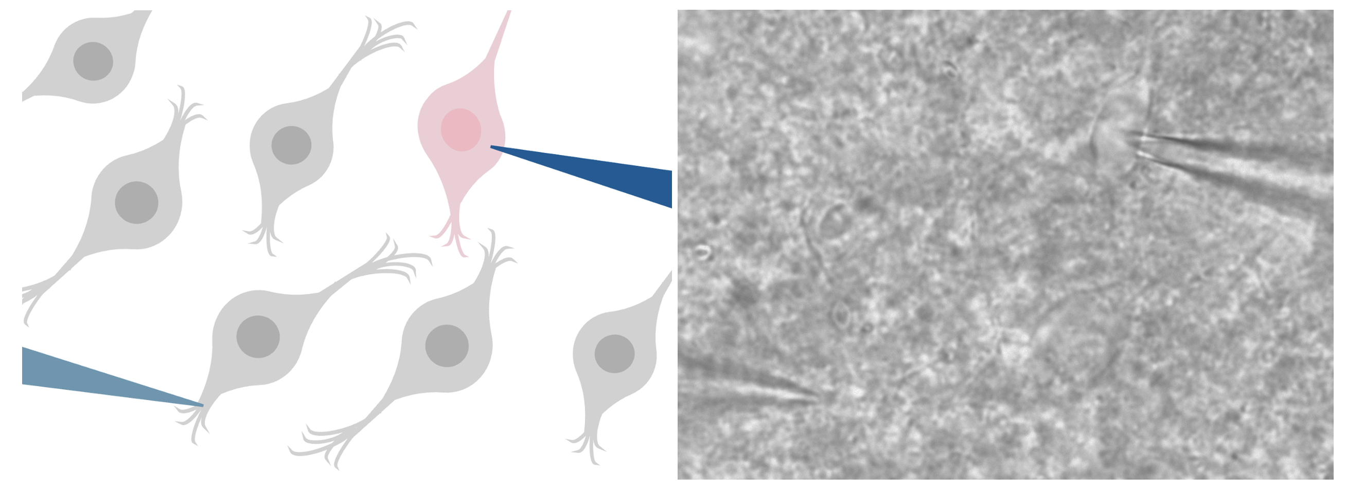
Methods: Recording from living neurons
Postsynaptic neuron
Presynaptic neuron

Slide 16
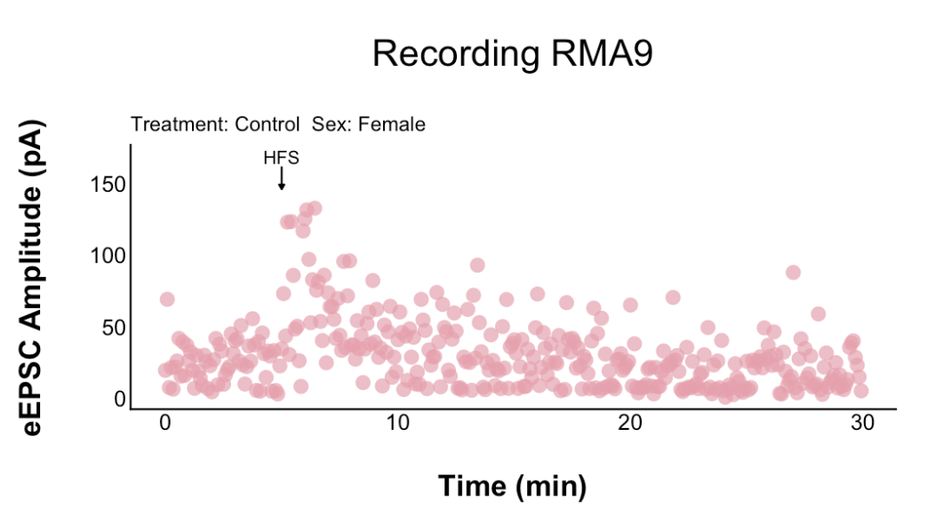
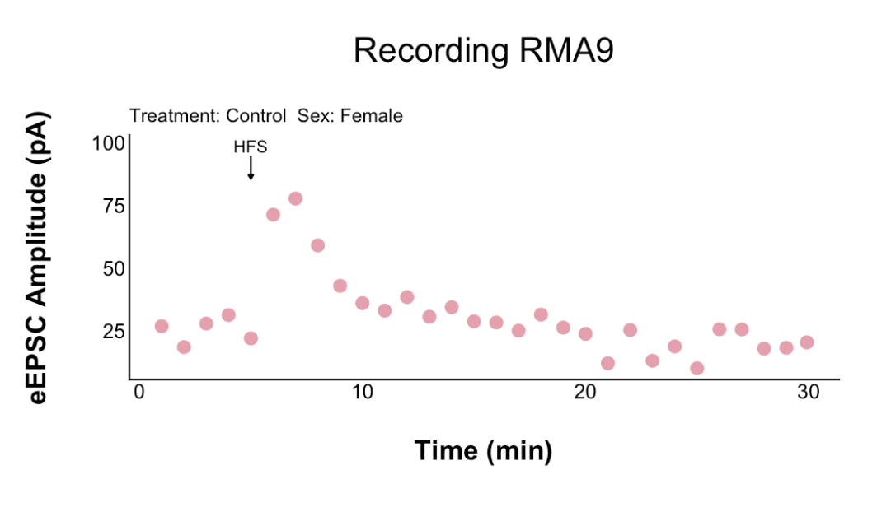
Methods: Recording from living neurons
Amplitude (pA)
Time (msec)

Slide 17
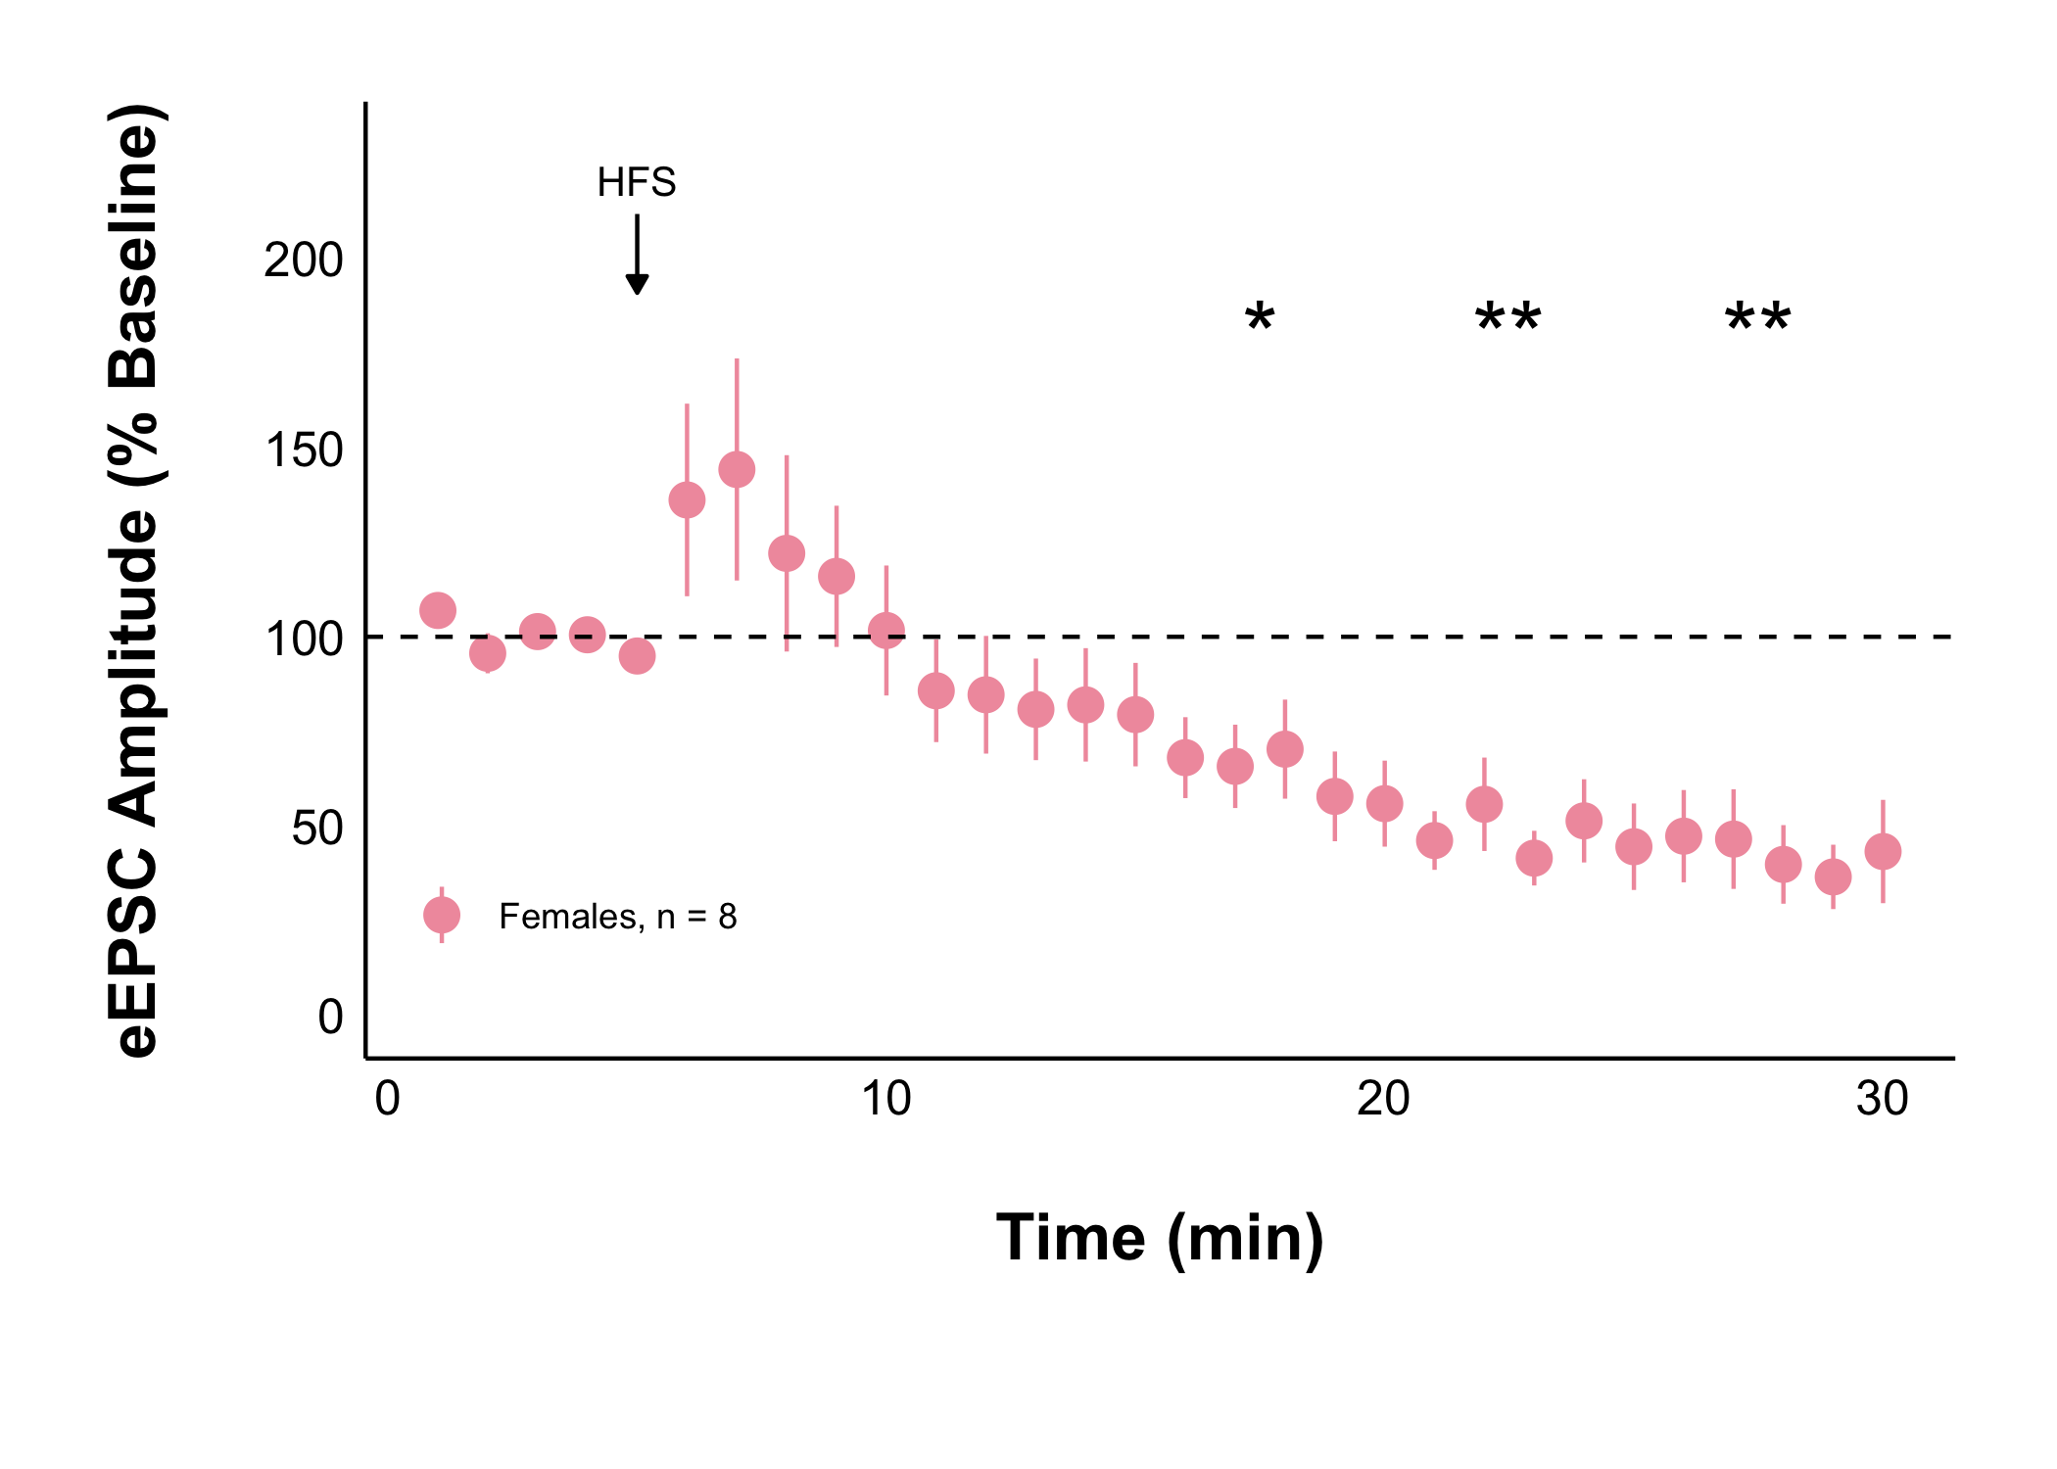

Slide 19
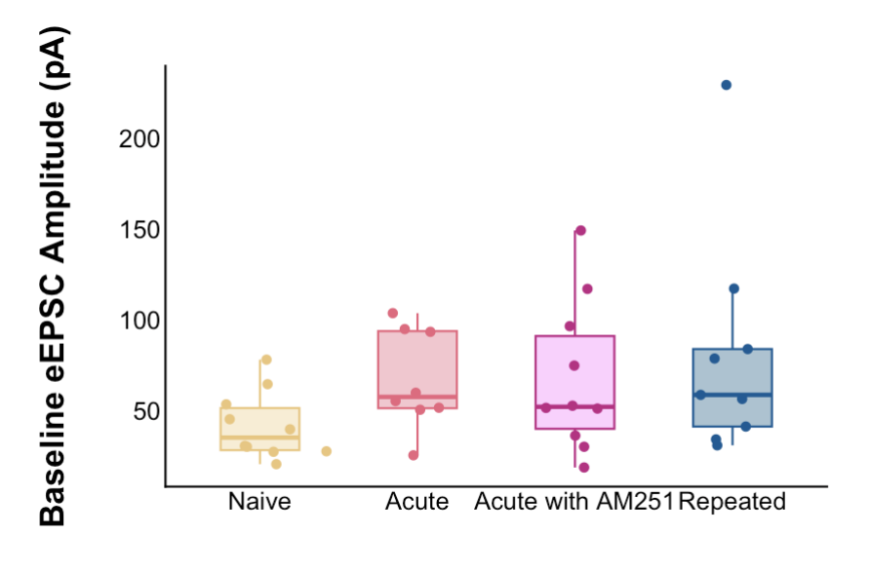
Variances are homogenous (0.4113)
Residuals are not normal (0.0003435)
Kruskal-Wallis p-value = 0.1387
Not significant

Slide 20
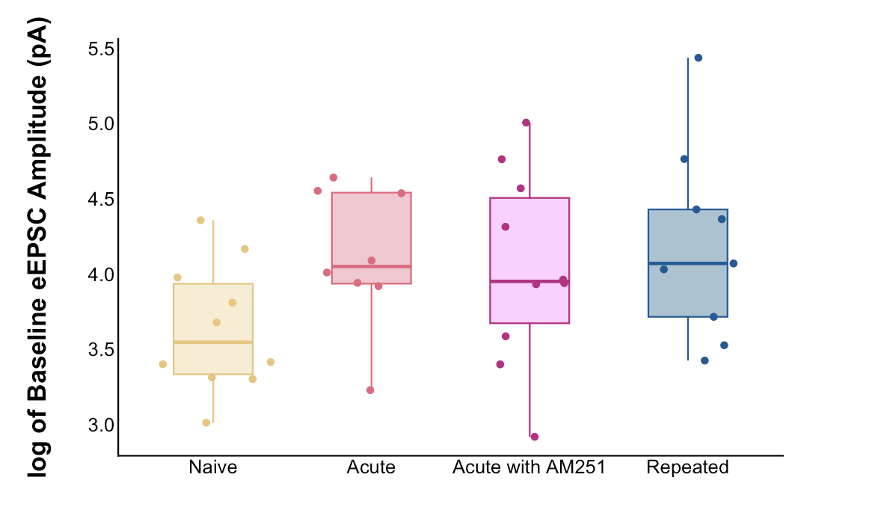
Log transformed
Variances are homogenous (0.7121)
Residuals are normal (0.979)
ANOVA p-value = 0.152
Not significant

Slide 21
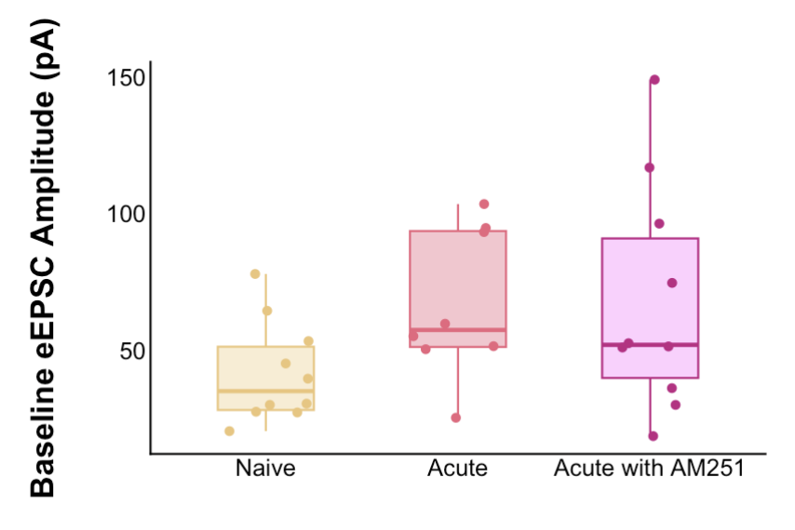
Variances are homogenous (0.3075)
Residuals are normal (0.1077)
ANOVA p-value = 0.13
Not significant

Slide 22
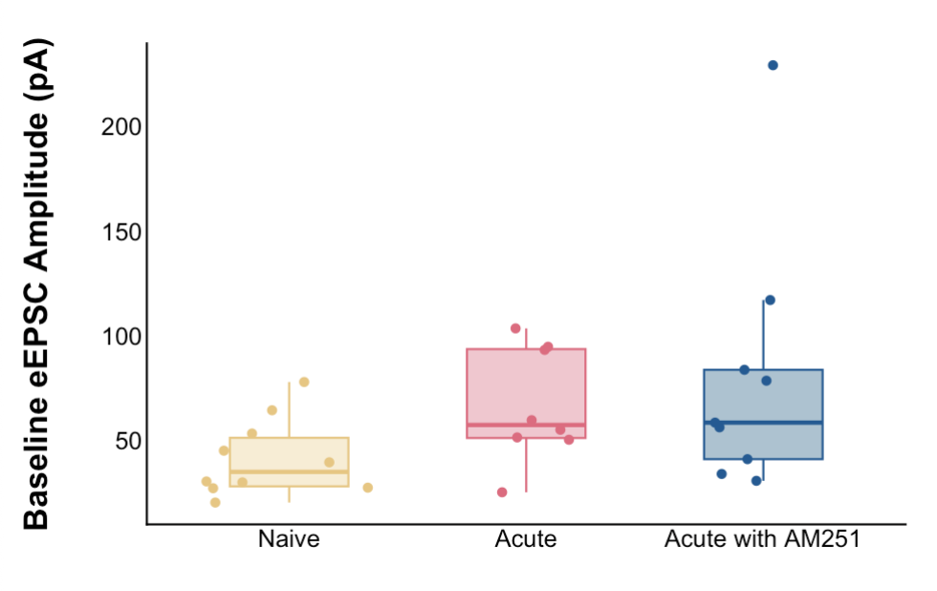
Variances are homogenous (0.2832)
Residuals are not normal (0.0002256)
Kruskal-Wallis p-value = 0.05411
Not significant
Repeated

Slide 23
Amplitude (pA)
Current 1
Time (msec)

Slide 24
PPR = P2/P1
Tells us about the probability of presynaptic neurotransmitter release
Amplitude (pA)
Current 1
Current 2
Time (msec)

Slide 25
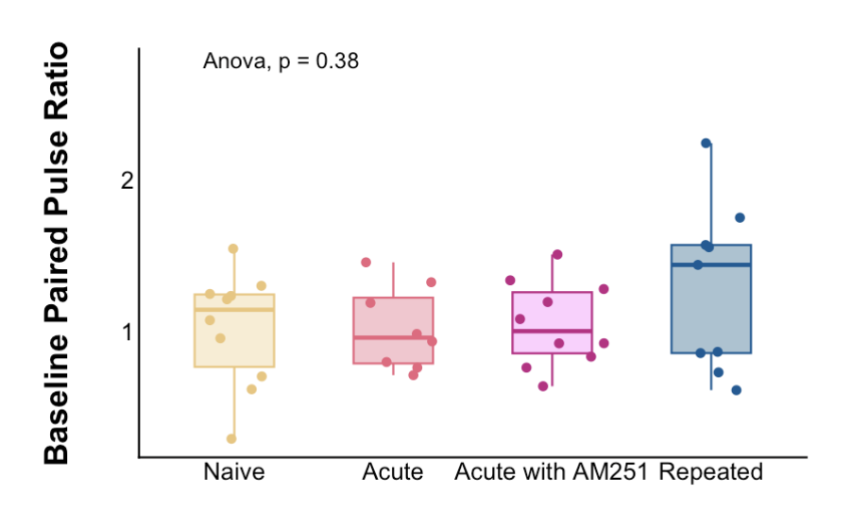
Variances are homogenous (0.05761)
Residuals are normal (0.663)
ANOVA p-value = 0.382
Not significant

Slide 26
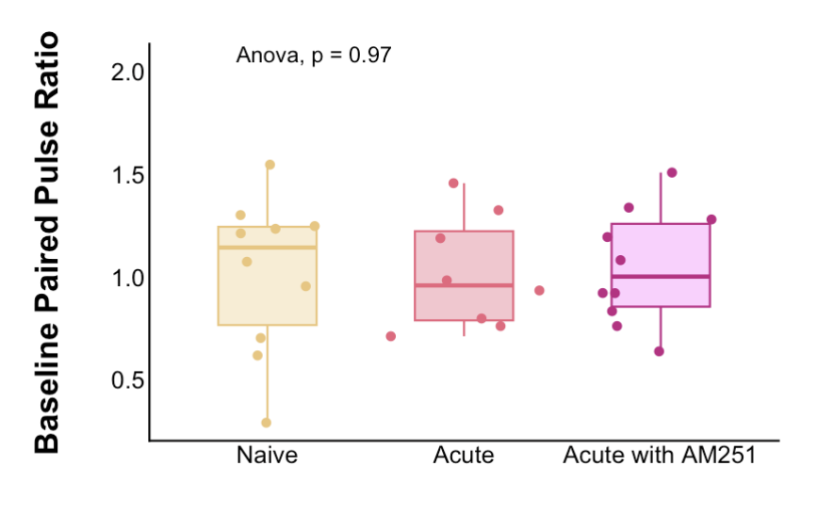
Variances are homogenous (0.3504)
Residuals are normal (0.6713)
ANOVA p-value = 0.974
Not significant

Slide 27
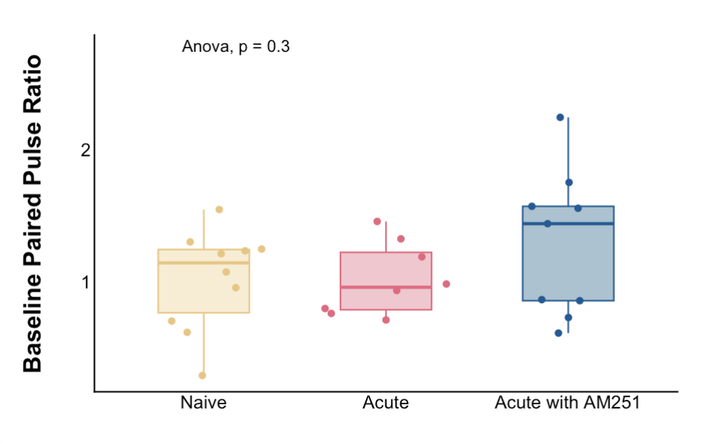
Variances are homogenous (0.1173)
Residuals are normal (0.6612)
ANOVA p-value = 0.302
Not significant
Repeated

Slide 28
What about long-lasting changes?
High Frequency Stimulation (HFS): allows for observation of long-term potentiation or depression
100 Hz for 4 seconds, twice, 20 seconds apart

Slide 29
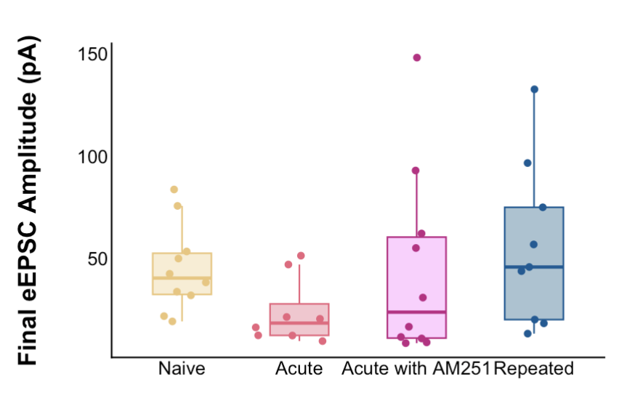
Variances are homogenous (0.4113)
Residuals are not normal (0.000363)
Kruskal-Wallis p-value = 0.1647
Not significant
Transforming made the HoV worse

Slide 30
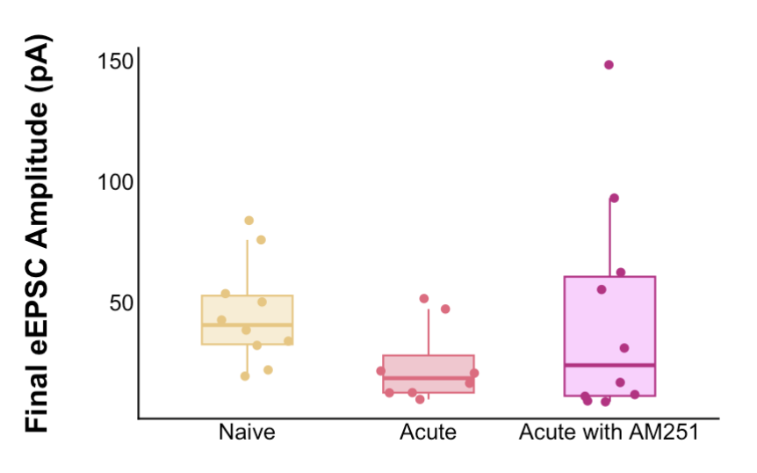
Variances are homogenous (0.1495)
Residuals are not normal (0.003404)
Kruskal-Wallis p-value = 0.1595
Not significant
Transforming made the HoV worse

Slide 31
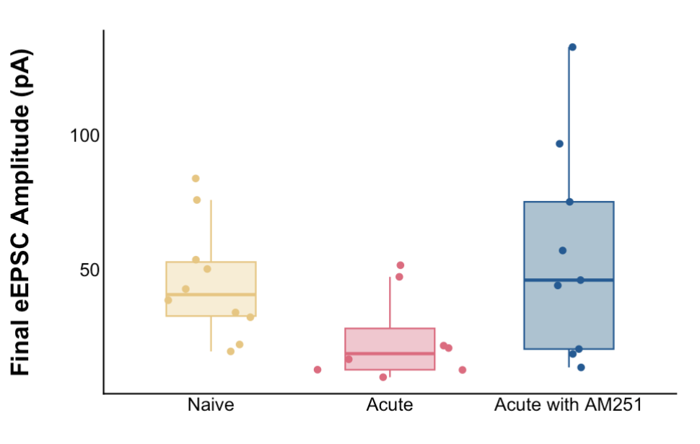
Variances are homogenous (0.2832)
Residuals are normal (0.08797)
ANOVA p-value = 0.0766
Not significant
Repeated

Slide 32
Final PPR

Slide 33
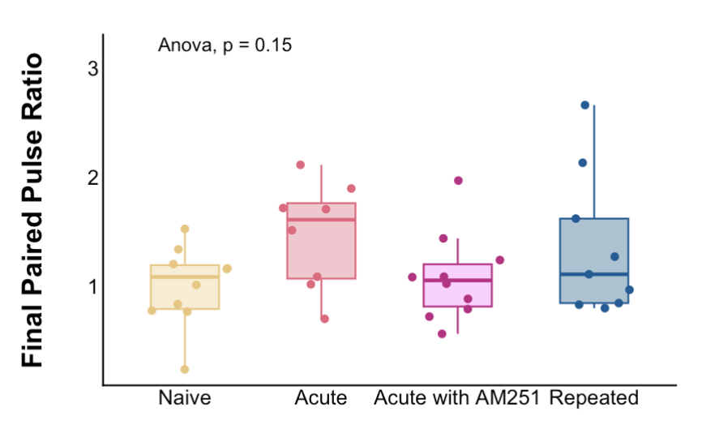
Variances are homogenous (0.05761)
Residuals are normal (0.3914)
ANOVA p-value = 0.149
Not significant
Repeated

Slide 34
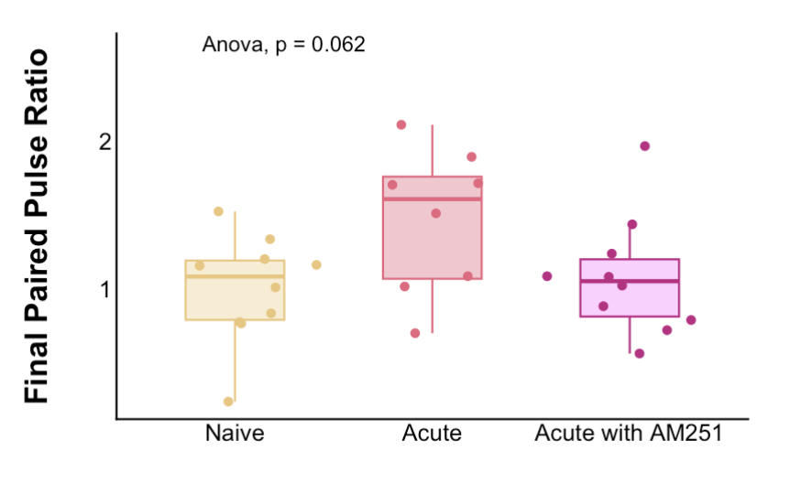
Variances are homogenous (0.3504)
Residuals are normal (0.9864)
ANOVA p-value = 0.0617
Not significant

Slide 35
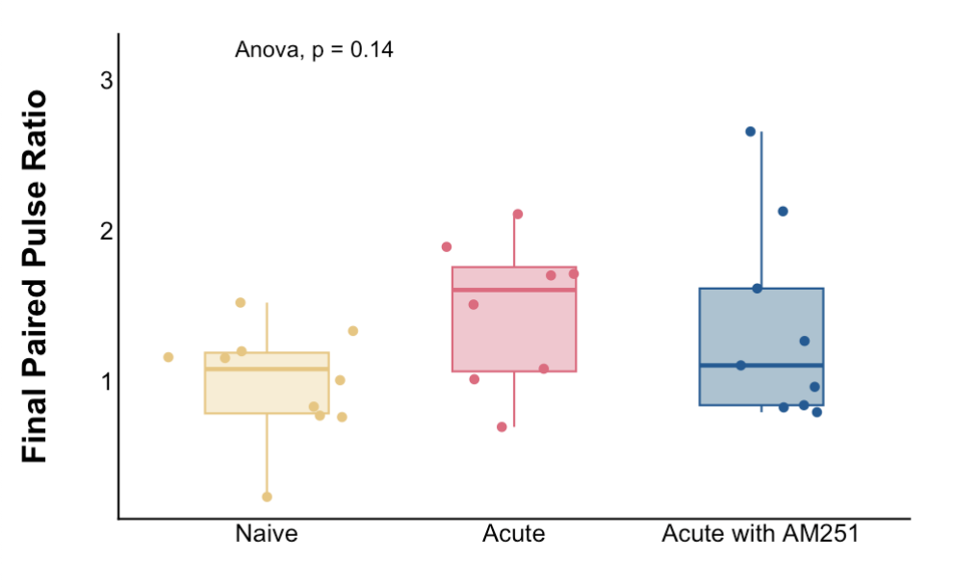
Variances are homogenous (0.1173)
Residuals are normal (0.5332)
ANOVA p-value = 0.143
Not significant
Repeated

Slide 36
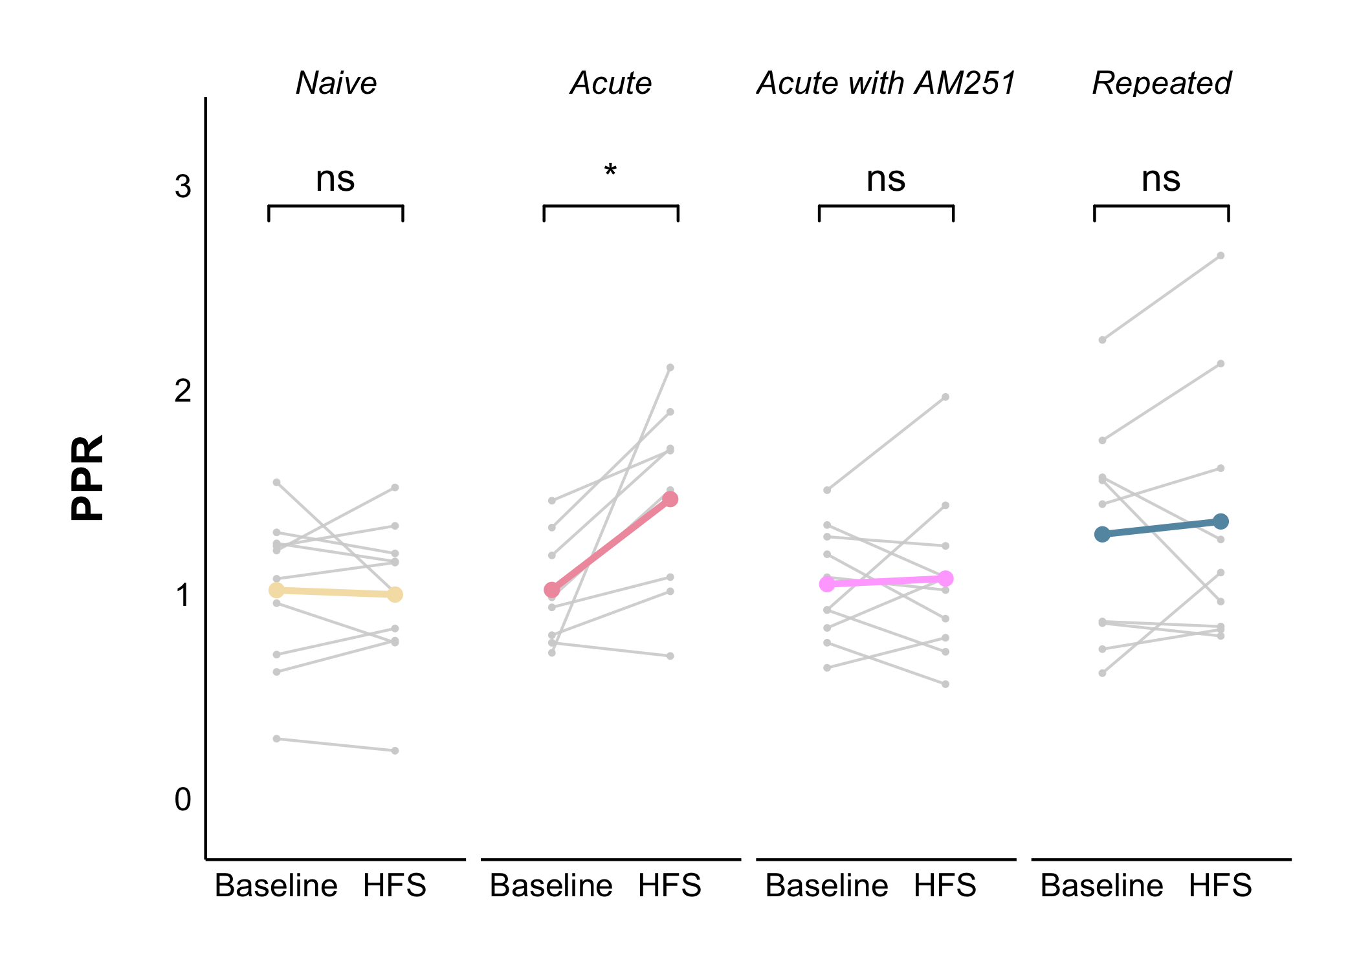
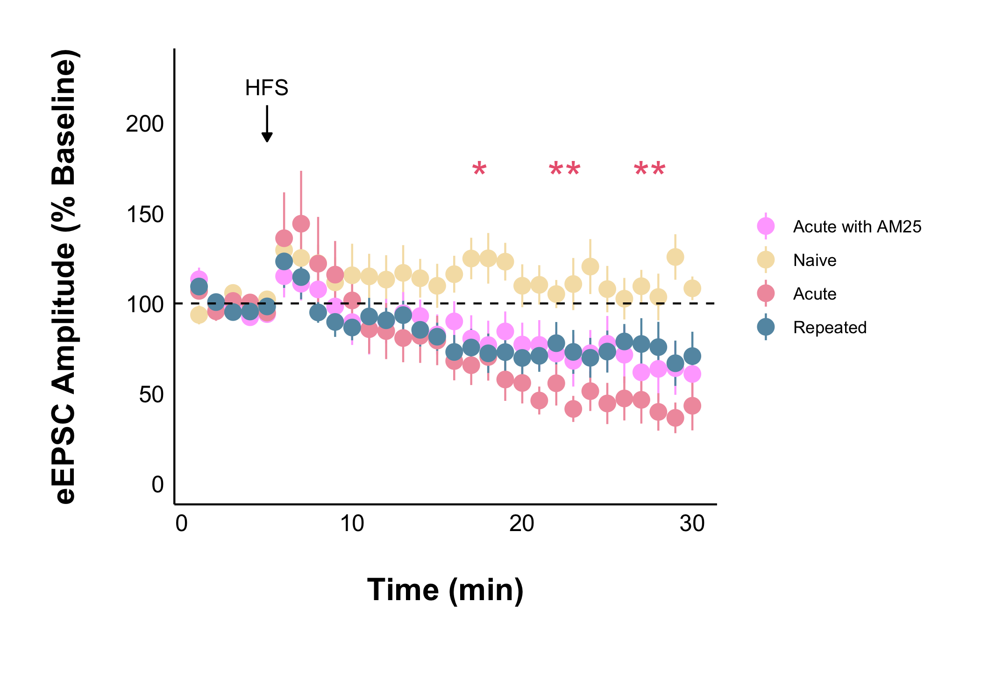
Summary of Current Data
I still think this is a valid use of t-tests so the acute is still a significant result ?

Slide 37
Summary of Current Data
Approaching significance:
Baseline eEPSC (naïve, acute, repeated) p = 0.05411
Final eEPSC (naïve, acute, repeated) p = 0.0766
Final PPR (naïve, acute, acute with AM251) p = 0.0617

Slide 38
Help.
I am now lost and aimless.
Was the AM251 for nothing?
Is there any point in doing cort on the slice?
Advanced biostats has made me loose faith in p-values.

